Slide 1

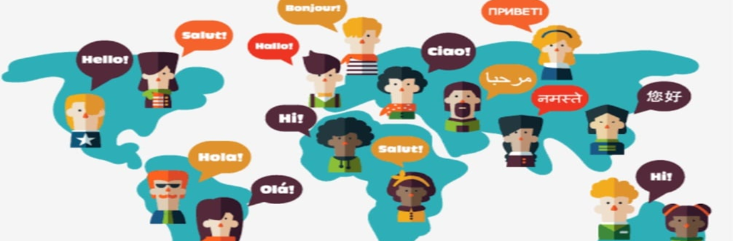
Evolution of Language: From Grunts to Global
Group -4B
Sajit kadam
Aditi Singh
Mrunmayi Sunkale
Rutuj Parab
-Mayur Shetty

Slide 2
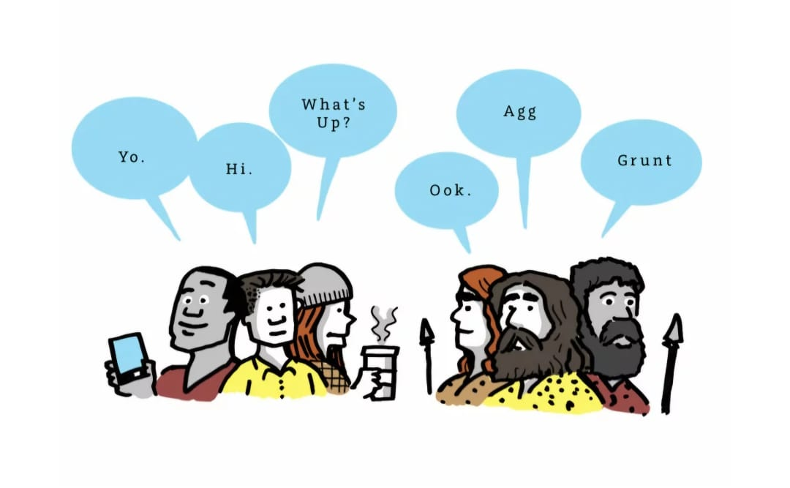
Introduction The Evolution of Language: From Grunts to Gestures

Slide 3

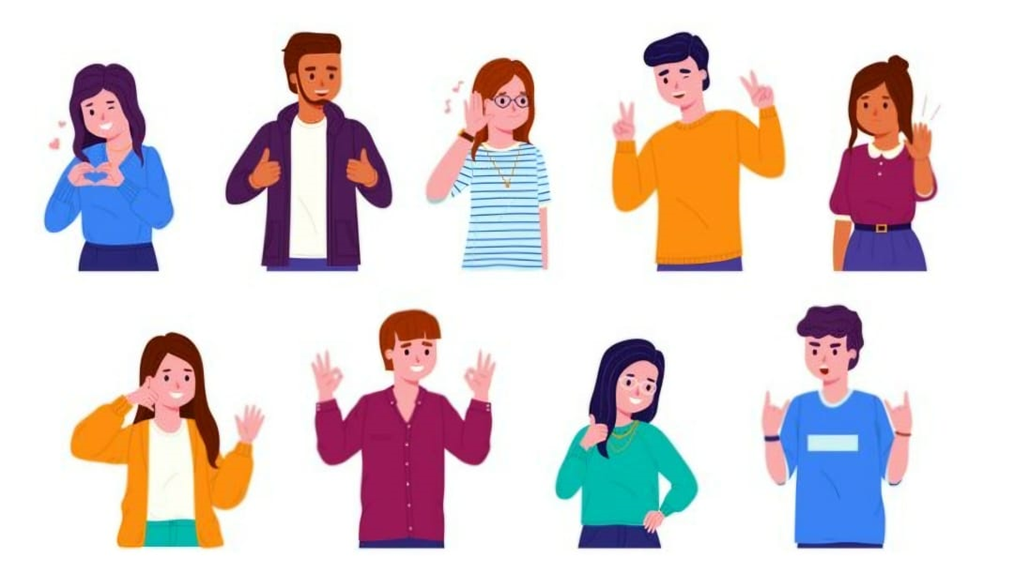
Early communications
Gestural Communication
Grunts

Slide 4
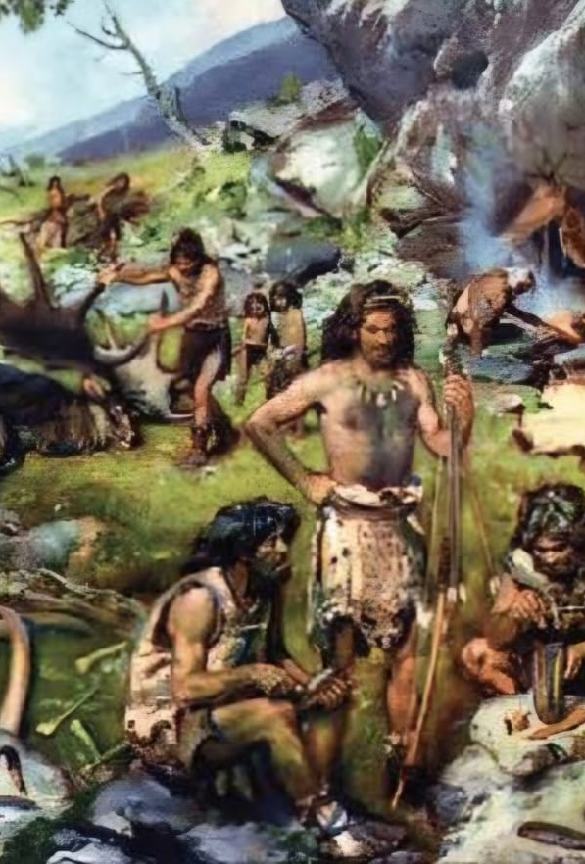
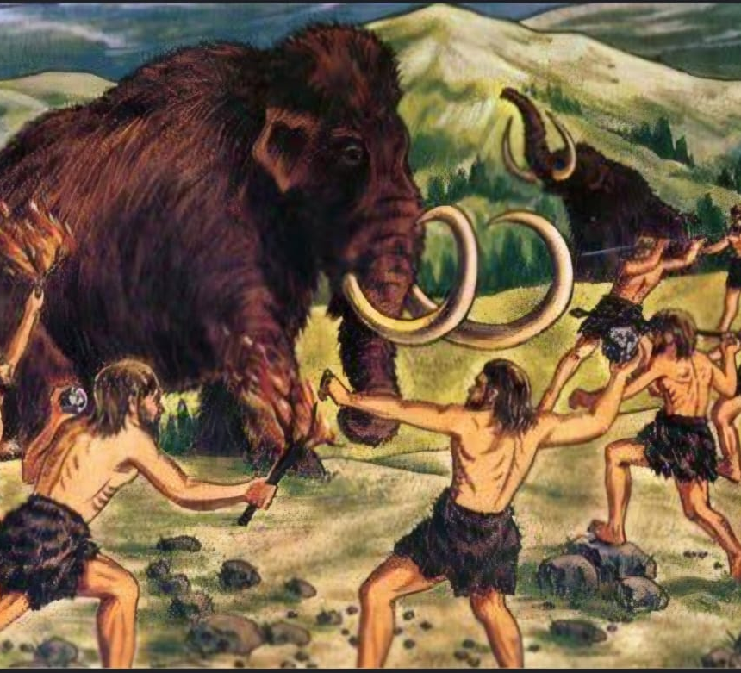
The Role of Grunts and Gestures
Conveying basic Needs
1
Expressing Emotions
2
Sharing information
3
Developing social bonds
4

Slide 5


Slide 6
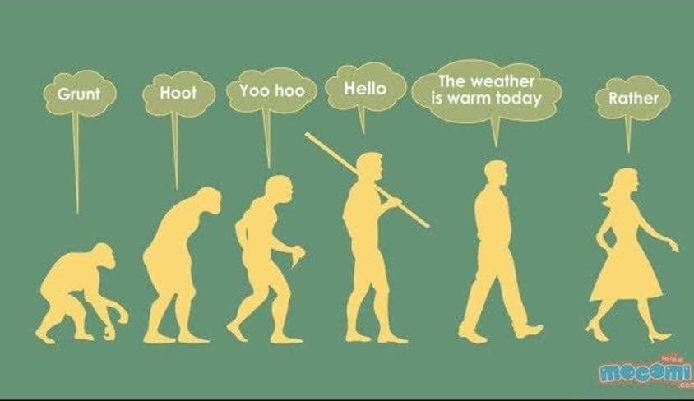
From Grunts to Grammar

Slide 7

THE DEVELOPMENT OF SPOKEN LANGUAGE
ANATOMICAL CHANGES
COGNITIVE LEAPS
SOCIAL ADVANTAGE
ADVANCEMENT IN VOCAL
MEMORY AND LANGUAGE
SOCIAL INTERACTION AND LANGUAGE

Slide 8
THE MOST SPOKEN LANGUAGES WORLD WIDE IN 2023

Slide 9
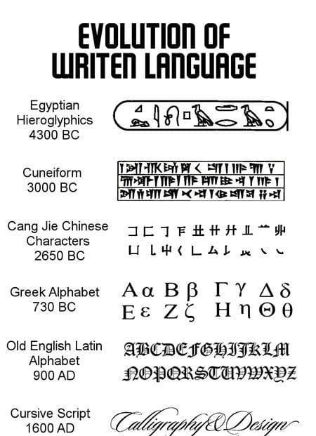
The Development of Written Language
Prehistoric Origins
Proto writing systems
Early writing systems
Development of alphabets
Modern writing system
Printing and Digital Writing

Slide 10

The Diversity of Global Languages
Mandarin Chinese
Spanish .
Hindi
Arabic
English

Slide 11
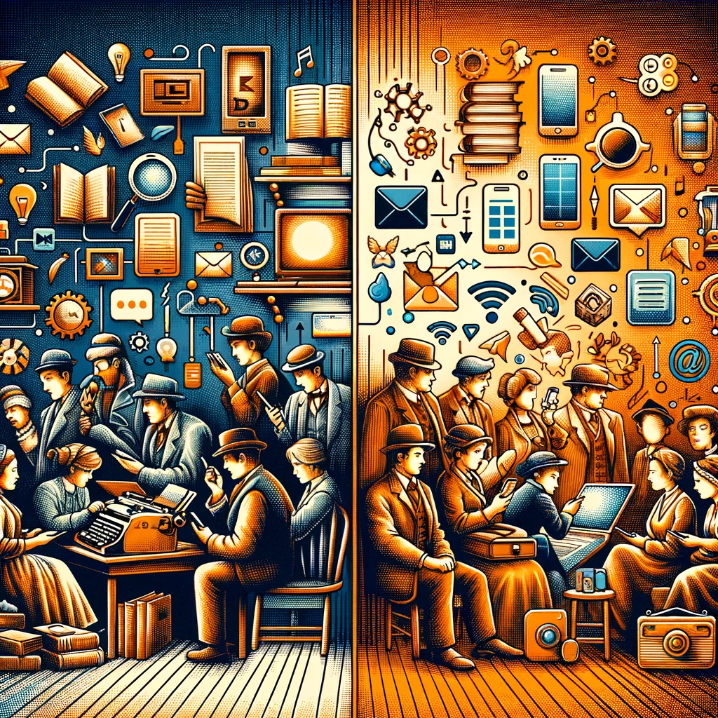
The Influence of Technology on Language Evolution
Digital Communication
Linguistic Preservation
Machine Translation
Language Barriers

Slide 12
The Importance of Language Preservation
Cultural Heritage and Identity
Preserving history: Languages are repositories of a community's history, traditions, and knowledge, often passed down orally through generations.
Strengthening identity: A language connects people to their roots, providing a sense of belonging and cultural pride.
Linguistic Diversity
Richness of thought: Each language offers unique ways of perceiving and expressing the world, contributing to global intellectual diversity.
Scientific advancement: Studying diverse languages can lead to breakthroughs in fields like linguistics, psychology, and computer science.

Slide 13
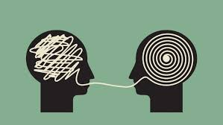
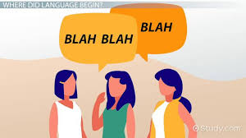
The Power of Language to Connect Humanity
Building Understanding
Cultural Exchange
Transcends border
Connects individual
Sharing of idea
Facilitates Networking

Slide 14

The Future of Language in a Globalized World
Influence of Social Media on Language Evolution
Informal Language
Emojis & Memes
Global Language Convergence
:
Collaborative Language Learning:
Online Communities:
Virtual Language Immersion:
Real-Time Translation:
AI-Powered Translators
Language Processing
Personalised language mode
Increased Multilingualism:
Global Business
Travel and Tourism

Slide 15
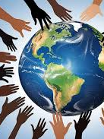
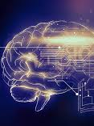
Conclusion
1. Language as a Bridge
Connecting Cultures
Enhancing Communication
2. Balancing Innovation and Tradition
Technological Benefits
Preserving Heritage
3. Adapting to Change
Embracing Multilingualism.
Continuous Learning
4. Future Prospects
Global Collaboration
Cultural Enrichment.

